Slide 1
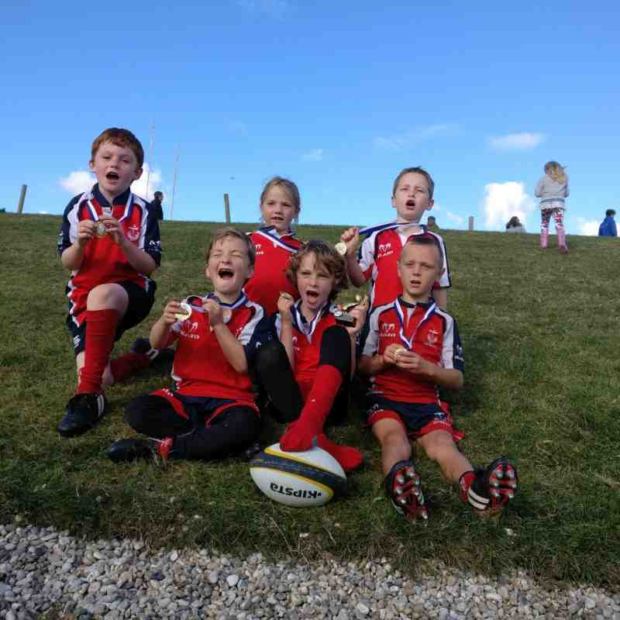
Seaford Rugby Football Club in the Community.
Come and try Tag Rugby in Peacehaven for Free!
Tag Rugby is a non contact version of the Sport.
Sessions are aimed at children of all ages.
Children should wear suitable clothes for playing sport but football/rugby boots are not needed.
Parents must stay with children through the sessions.
Sessions will run through the summer holidays at
THE BIG PARK PROJECT
Peacehaven
Dates: 25th July 8th 15th 22nd 29th August
4.30pm – 5.30pm.
For More information please contact us at:
seafordrfcydo@hotmail.com

